Slide 1

diagnosis of DENTAL CARIES
PRESENTED BY:
DR. MANUJA NAIR

Slide 2
CONTENTS
NEED FOR DIAGNOSIS
OBJECTIVES
REQUIREMENTS
BASIC AIDS
RECENT ADVANCES
REFERENCES

Slide 3
definition
Diagnosis is defined as the “art or act of identifying a disease from its signs and symptoms”

Slide 4
Need for diagnosis
Why is diagnosis important?
Forms the basis of treatment decision.
Enables to advice and inform the patient.
At population level it advices health service planners.

Slide 5
1. Identifying those lesion that require nonsurgical TREATMENT 2. Identifying those lesion that require surgical (restorative) treatment. 3. those person who are at high risk for developing caries 4. Early detection of incipient caries 5. limitation of caries before Significant tooth destruction
OBJECTIVES OF CARIES DIAGNOSIS

Slide 6
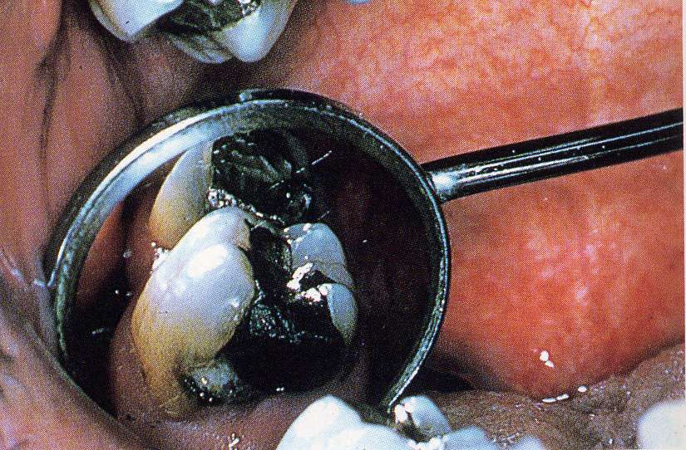
1. Patient history 2. Clinical examination 3. diet analysis 4. Salivary analysis 5. Radiographic assessment
ASSESSMENT TOOLS

Slide 7
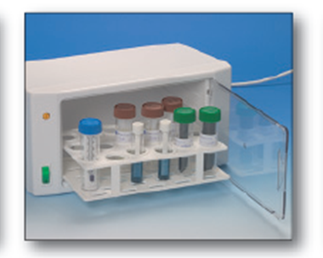
• ACCURATE • SENSITIVE • SPECIFIC • REPRODUCIBLE • RELIABLE • NOT TRANSFER INFECTION • COST EFFECTIVE
DIAGNOSTIC TEST MUST BE

Slide 8
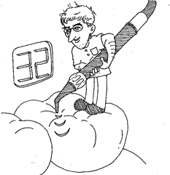
Methods of diagnosis
Conventional techniques:
Visual observation
Tactile inspection
Radiography:
Intra-oral periapical radiographs
Bitewing radiographs
Recent advances:
Dental digital radiography
Caries-detector dyes
Fiber-optic transillumination
Quantitative light-induced fluorescence
Laser fluorescence
Ultrasound
Electroconductivity measurements

Slide 9
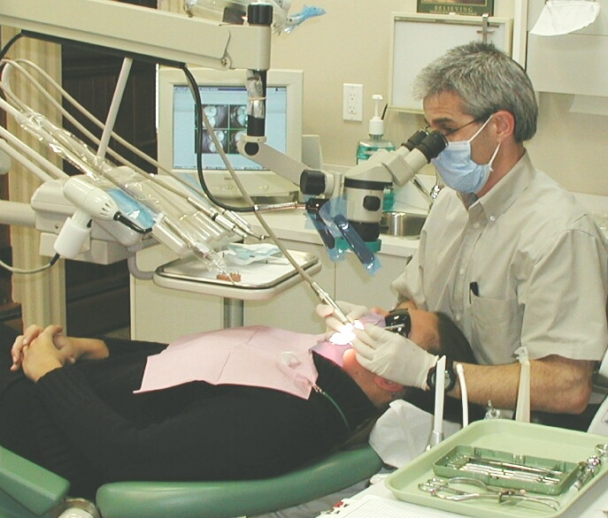
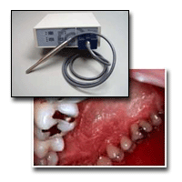
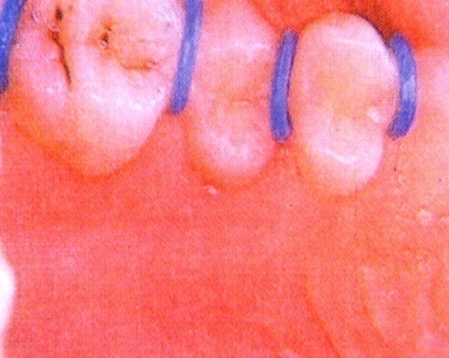
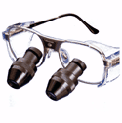
VISUAL

Slide 10
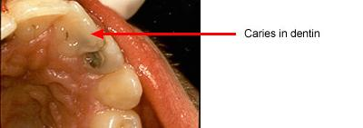
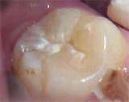
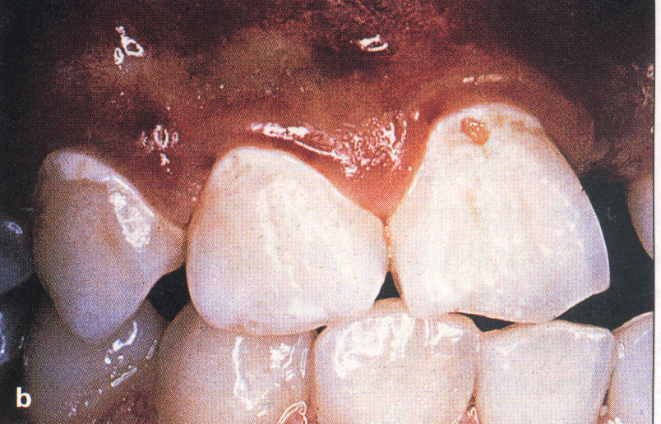
Discoloration of teeth
White spot on teeth
Clinically visible(frank cavitation)
Surface roughness

Slide 11
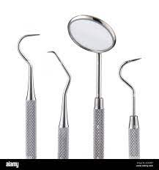
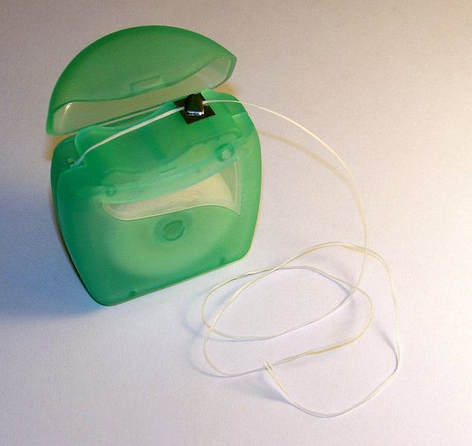
TACTILE EXAMINATION
INSTRUMENT:
Mouth mirror
Explorer
Probe
Floss
CRITERIA OF TACTILE EXAMINATION:
Roughness & softness of the surface
Catch is present
Soft floor of cavitation is palpable with probe

Slide 12
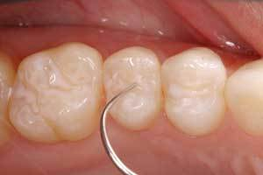
CATCH MEANS :
Penetration & resistance to removal
Catch indicates demineralization & weakening of tooth surface
MECHANICAL BINDING OF EXPLORER DEPENDS ON :
Shape of fissure
Sharpness of explorer
Force of application
Path of explorer placement

Slide 13
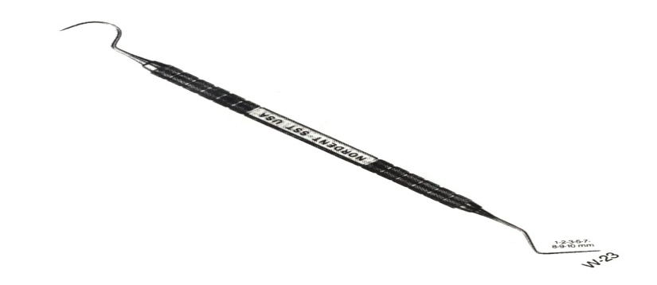
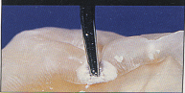
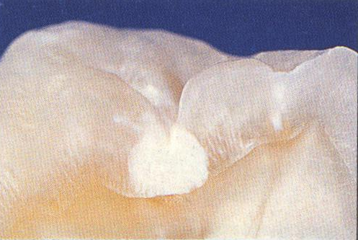
DISADVANTAGE OF USE OF EXPLORER
Physical damage to small lesion with intact surface
Probing may lead to fracture & cavitation in incipient lesion
Mechanical binding of explorer in deep pit & fissure leading to feeling of catch

Slide 14
RADIOGRAPHY
CONVENTIONAL RADIOGRAPHY - IOPA,
BITEWING
DIGITAL
XERORADIOGRAPHY
SUBTRACTION RADIOGRAPHY
COMPUTERISED TOMOGRAPHY

Slide 15
RADIOGRAPHIC EXAMINATION
Lesion that is not visible clinically
40% demineralization

Slide 16
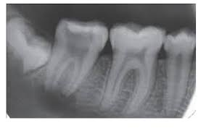
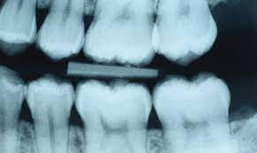
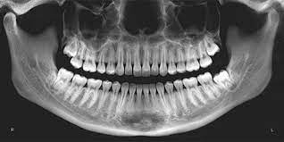
RADIOGRAPH FOR DENTAL CARIES IOPA Bitewing Radiographs OPG

Slide 17
Advantages:
non-invasive method
discloses site inaccessible to other diagnostic methods.
helps in maintaining a permanent record of progress or arrest of carious lesions.
Disadvantages:
only a 2-D image of 3-D object.
Unable to detect earlier stages of caries development.
radiolucency may be due to caries, wear, fracture, or cervical burn out.
interpretation is subjective
extent of caries as seen in the radiographs is usually lesser than actual defect.

Slide 18
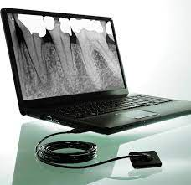
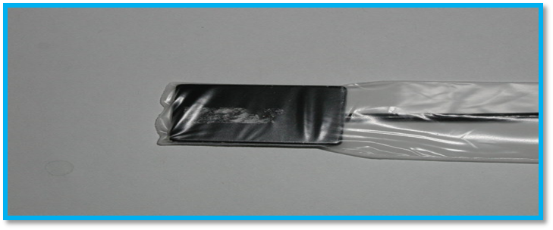
DIGITAL RADIOGRAPHY
Radiovisiography. RVG

Slide 19
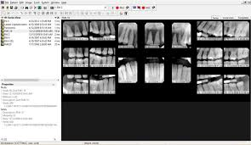

Slide 20
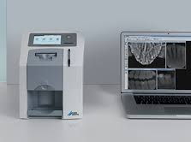
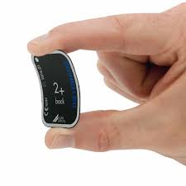
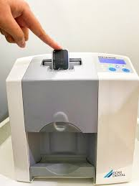

Slide 21
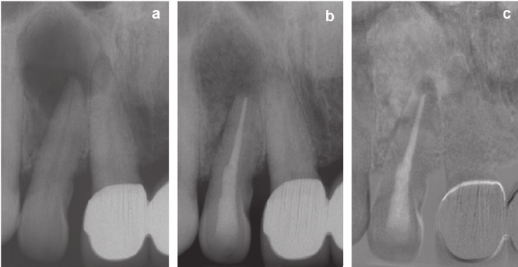
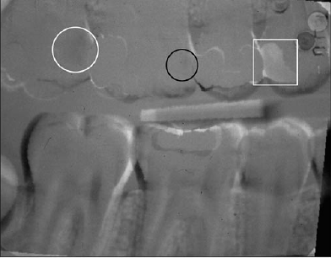
SUBTRACTION RADIOGRAPHY
When two radiographs are recorded with partially controlled projection angles,the information from the most recent one can be digitally subtracted from the former.
Optimally all unchanged anatomical areas will cancel, and changed areas will be displayed in a neutral grey shade

Slide 22
XERORADIOGRAPHY
It simulates the photocopying machine.
It is a technique in which the image is recorded on an aluminium plate coated with a layer of selenium particles.
When x- rays are passed on this film, it causes selective discharge of particles.
This forms a latent image and converted to a positive image

Slide 23
ADVANTAGES:-
Reduce radiation dose.
Instant image visualization
No need for dark room
No processing error
Image can be magnified
Contrast and density of image can be enhanced.
DISADVANTAGES:-
Expensive
Sensors are larger and placement takes some practice

Slide 24
Recent diagnostic aids

Slide 25
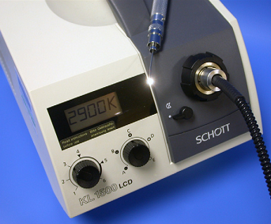
FIBER OPTIC TRANSILLUMINATION (FOTI)

Slide 26
phenomenon of light scattering.
Sound enamel: almost transparent structure.
demineralisation,→ light is scattered
uses a high intensity white light that is presented through a small aperture in form of dental handpiece.
Light is shone through tooth
scattering effect seen as shadows
it can be used for detection of caries on all surfaces
Specially at proximal lesions

Slide 27
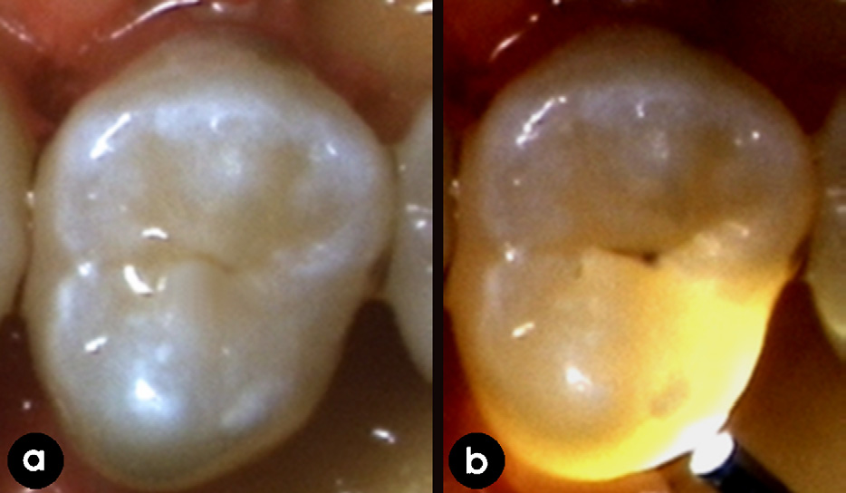
Limitations:
Subjective
not possible to record

Slide 28
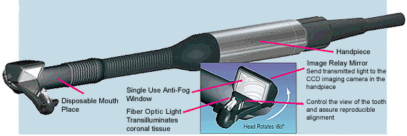
DIFOTI (Digital Imaging Fibre-Optic Transillumination)

Slide 29
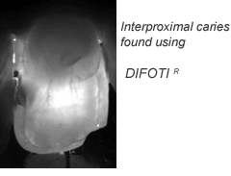
high intensity light and grey scale camera
two heads
one for smooth and one for occlusal surfaces.
subjective call based on the appearance of scattering

Slide 30
Advantages:-
- instantaneous image projections
- image quality is easy to control
- can detect incipient & recurrent caries very early
- non invasive
Disadvantages :-
Doesn’t measure the depth of lesion
Difficult to distinguish between deep fissure , stain and dental caries.

Slide 31
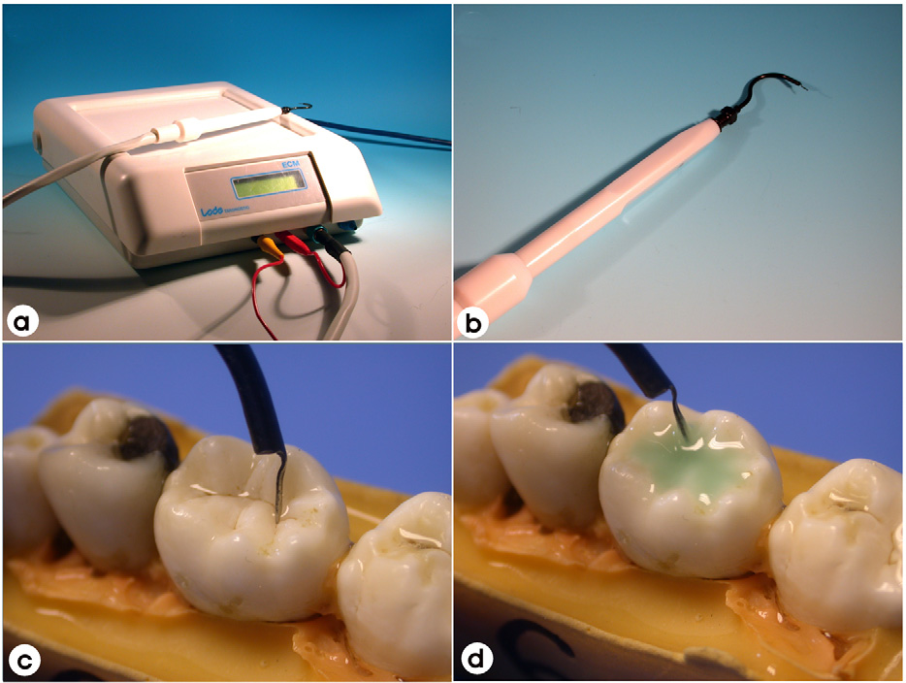
ELECTRIC CONDUCTANCE MEASUREMENT
Sound enamel → limited /no conductivity
Carious or demineralized → measurable conductivity
Probe→ current is passed
Substrate→ tooth,
Contra-electrode→ metal bar held in patient’s hand.
Caries result in an increase in porosity of tissue
higher fluid content than sound tissue

Slide 32
Electronic caries monitor

Slide 33
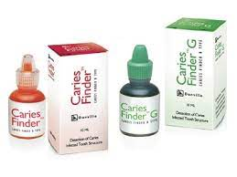
CARIES DETECTOR DYES
Principle:
Increased porosity→ through the development of capillary like micro voids- is earliest change in carious lesion
For Enamel caries: CALCEIN
ZYGLO
ZL-22
For Dentin caries:
0.5% FUSCHIN
1% ACID RED SOLUTION IN 0.2% PROPHYLENE GLYCOL
AMINO ACRIDINE

Slide 34
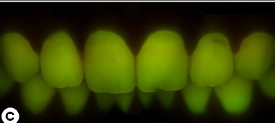
FLUORESCENCE technique
Visible light fluorescence—QLF
Laser fluorescence—DIAGNODent

Slide 35
Visible light fluorescence—QLF

Slide 36
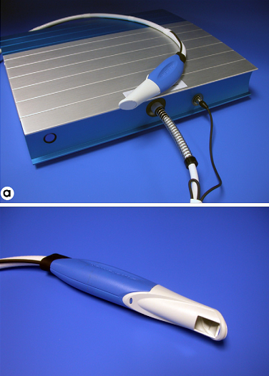
Quantitative light-induced fluorescence (QLF)

Slide 37
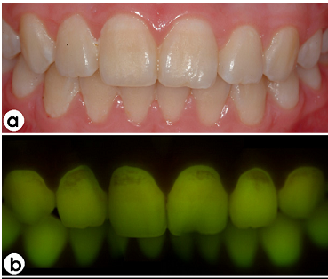

Slide 38
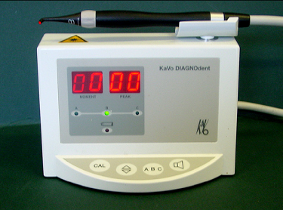
Laser fluorescence—DIAGNODent

Slide 39
Laser Fluorescence
Use of fluorescence for detection dates back 1929, when Benedict observed that normal teeth fluoresce under UV illumination.
Aids in the detection of occlusal caries

Slide 40
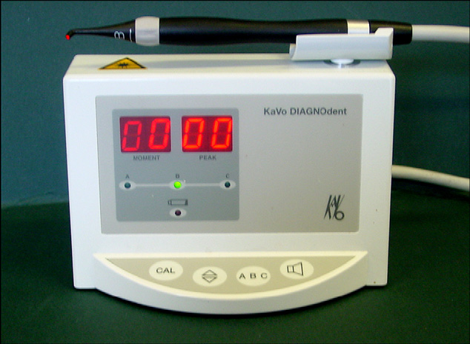
DIAGNODent (DD) instrument (KaVo, Germany)

Slide 41
9 to 99.
-9 indicates healthiest teeth
0-10 →sound tooth
10-20 →surface enamel caries
20-30 → deeper enamel caries
> 30 → dentinal caries

Slide 42
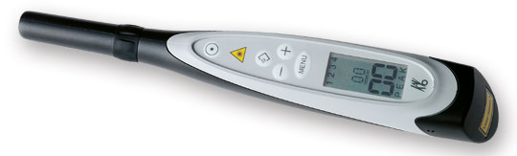
DIAGNODENT

Slide 43
Limitations:
Cannot determine the depth of lesion.
Reading may alter due presence of food debris, plaque.
Not able to detect recurrent caries.
Reading changes at different angulations of probe tip.
Caries indicator dyes cannot be used simultaneously with diagnodent.

Slide 44
Ultrasound techniques

Slide 45
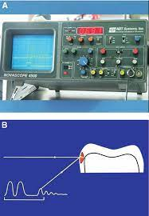
Ultrasonic Caries Detector (UCD)

Slide 46
CARIES ACTIVITY
Caries activity is a measure of speed of progression of a carious lesion.
CARIES SUSCEPTIBILITY
Refers to the inherent tendency of the host & target tissue, the tooth to be affected by the carious process

Slide 47
Various caries activity tests :
Lactobacillus colony test
Calorimetric synder test
The Swab test
Salivary buffer capacity test
Enamel solubility/ susceptibility test
Salivary reductase test
Alban test
Streptococcus mutans screening test
- plaque/tooth pick method
- saliva/tongue blade method
Fod stick calcium dissolution test
Dewar test

Slide 48
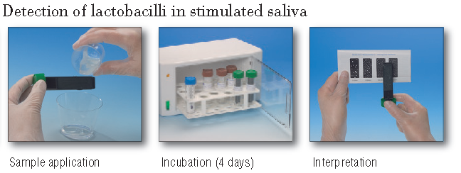
Lactobacillus Colony Count Test ( Hadley , 1933)

Slide 49
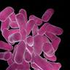
LACTO BACILLUS COLONY COUNT
PROCEDURE:
The no: of lactobacilli / c.c of saliva
is then calculated
RESULTS:
No of lacto bacillus per c.c Caries activity
0-1000 Little or none
1000- 5000 Slight
5000-10,000 Moderate
> 10,000 Marked

Slide 50
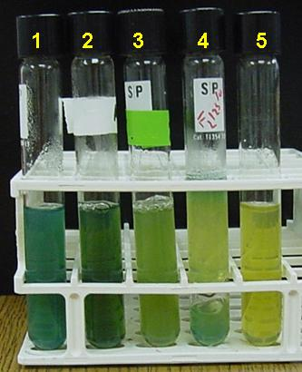
SNYDER TEST:
Action : This test measures the ability of salivary microorganisms to form organic acid from a carbohydrate medium.
Procedure: 0.2 ml of saliva is pipetted into a test tube of agar with bromocresol indicator, incubated at 37°C. This dye changes colour from green to yellow in the range of ph 5.4-3.8.
The color change is observed after 24, 48 and 72 hours of inculcation .The rate of colour change is indicative of degree of caries activity.
Results 24hours 48 hours 72hours
Color yellow yellow yellow
Caries activity Marked definite limited
Color Green green green
Caries activity Continue test continue test inactive

Slide 51
Swab Test :
Principle Involved: same as synder s test.
Swab the buccal surface of teeth with a cotton applicator incubated, change in Ph following 48hr incubation noticed.
Interpretation:
Ph 4.1, < 4.1  marked caries activity
Ph 4.2 - 4.4 Active
Ph 4.5 - 4.6  Slightly active
Ph 4.6 & over  caries inactive
Adv: No collection of saliva is necessary.
Useful to estimate caries activity in young
patients.

Slide 52
SALIVARY BUFFER CAPACITY TEST
Principle: Buffer capacity can be quantitated using either a pH meter or colour indicator. This test measures the number of milliliters of acid required to lower the pH of saliva through an arbitrary p H interval ,such as form pH 7.0 - 6.0 , or the amount of acid or base necessary to bring indicators to their end point.
Evaluation:
There’s an inverse relationship between buffering capacity of saliva and caries activity.
Advantage :
Simple to carry out
D/Advantage:
Does not correlate adequately with caries activity.

Slide 53
Limitations of caries activity tests:
None of the tests are highly reliable as indicators of expected caries increments.
These tests are unexpected as they measure a single parameter such as acid produced or colony counts of bacterial species.

Slide 54

T H A N K Y O U
The eyes do not see what the mind does not know

